Slide 1
Match Results 2016
Postgraduate Medical Education
School of Medicine  Faculty of Health Sciences  Queen’s University

Slide 2
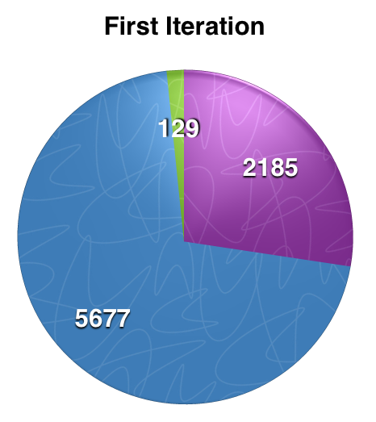

Number of Applicants and Number of Available Positions

Slide 3
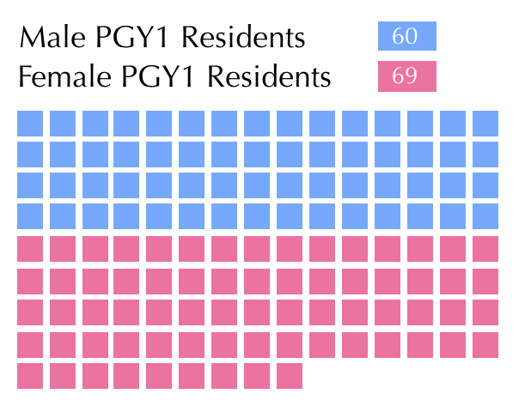
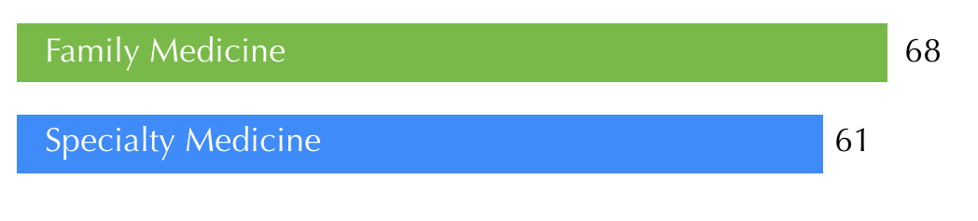
Entering Class of 2016

Slide 4
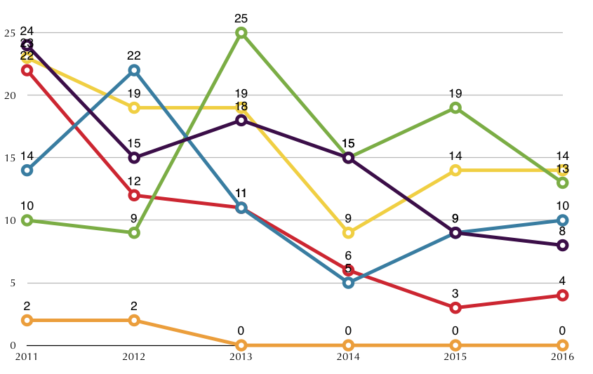
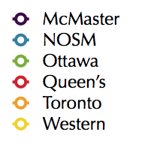
Number of Unfilled Positions After First Iteration 2011-16

Slide 5
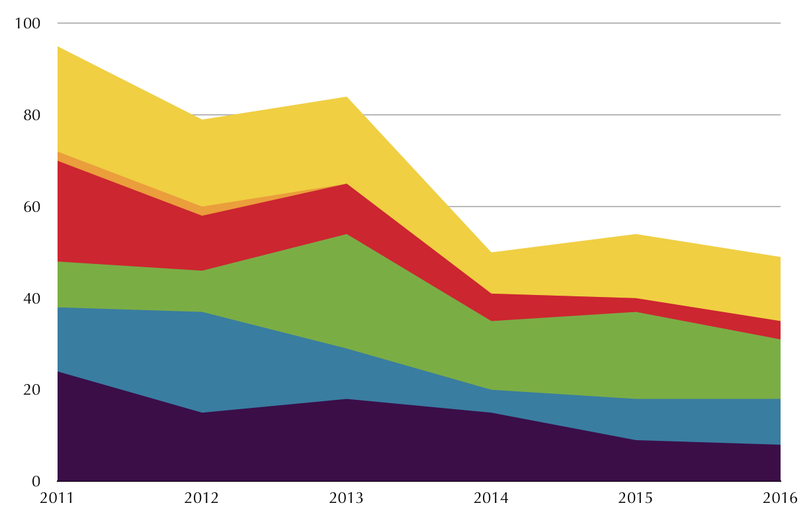

Total Number and Distribution of Unfilled Positions by School 2011-2016

Slide 6
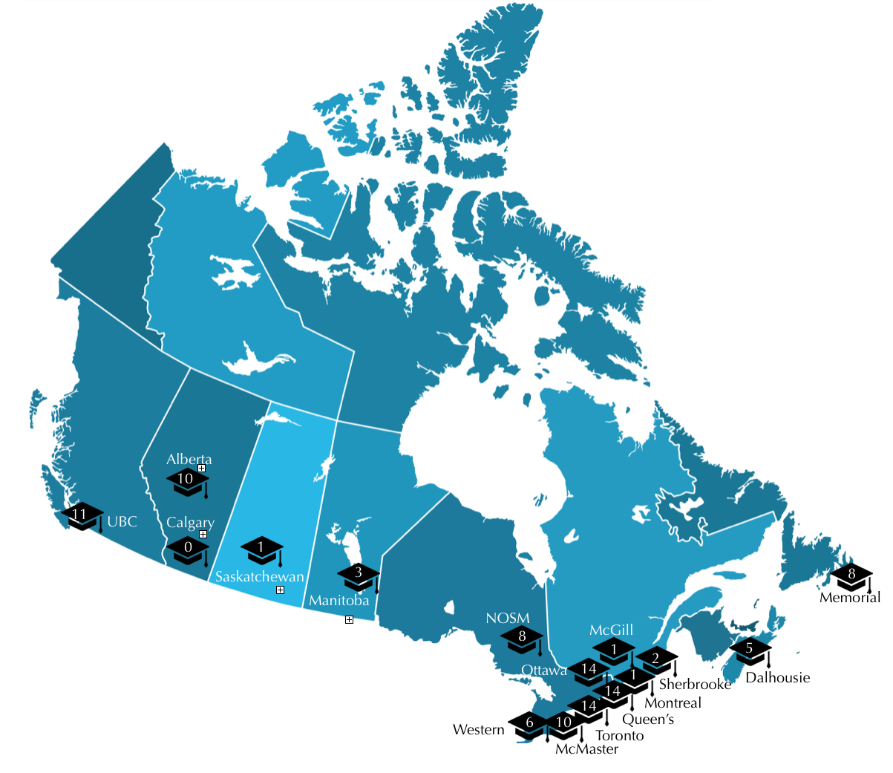
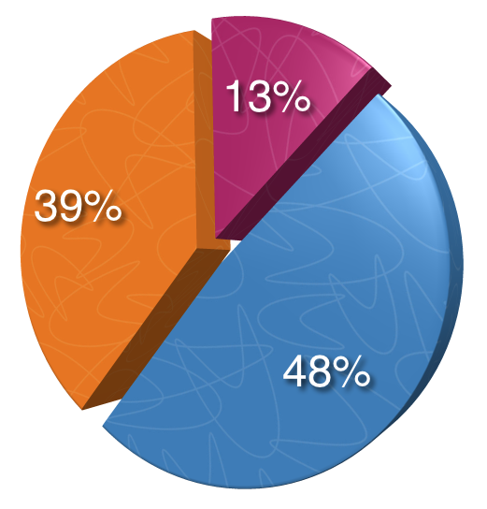
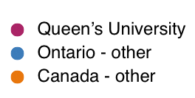
Match Results by School of Graduation

Slide 7
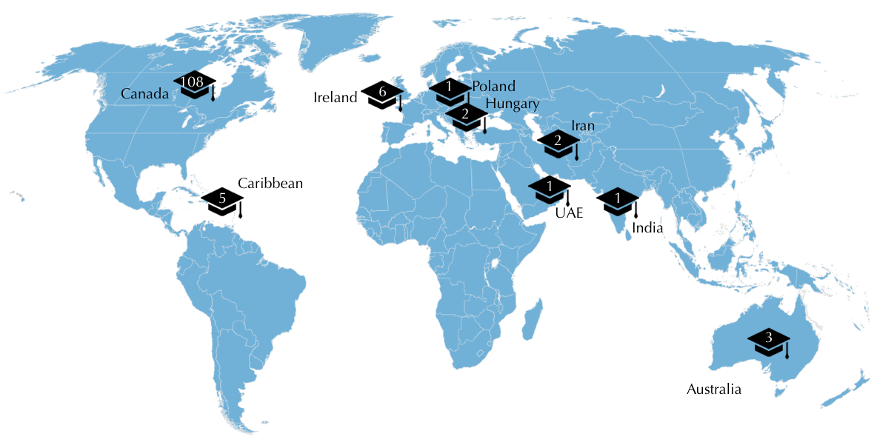
Match Results by Country of Graduation

Slide 8
Entering Class - Overview

